Slide 1
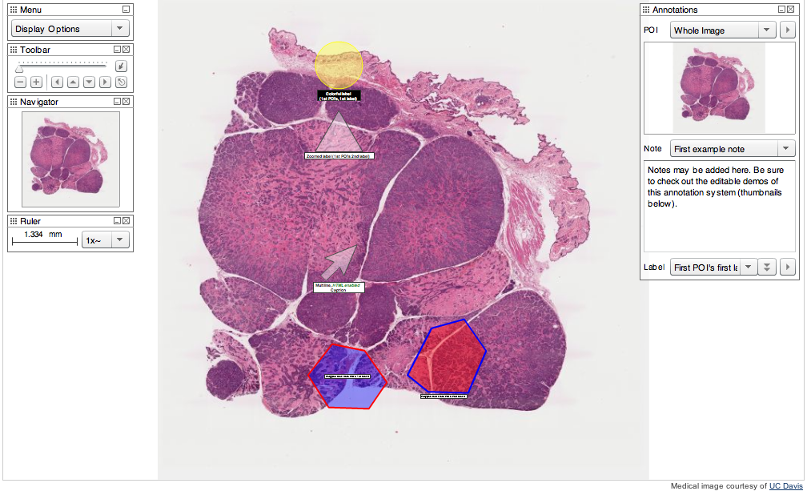
ROI Tool interaction
1) Zoomify enterprise version
Notes:
This tool has additional features that would not be necessary for the first phase of work.

Slide 2
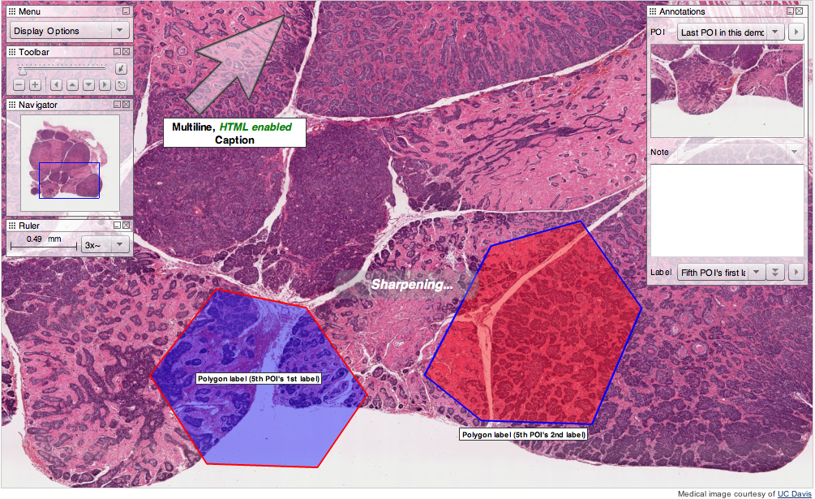

Slide 3
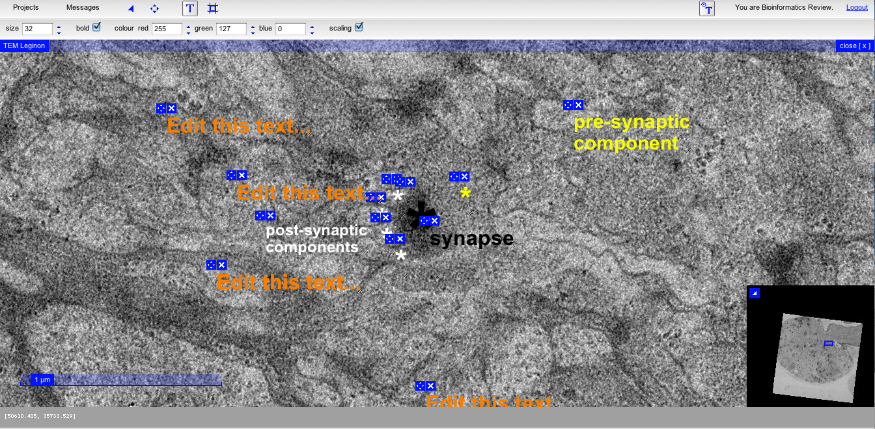
CATMAID: Collaborative Annotation Toolkit for Massive Amounts of Image Data
http://fly.mpi-cbg.de/~saalfeld/catmaid/
Major Limitations - No ability to move and delete the text only.
- Not able to view image without text/ROI annotation?

Slide 4
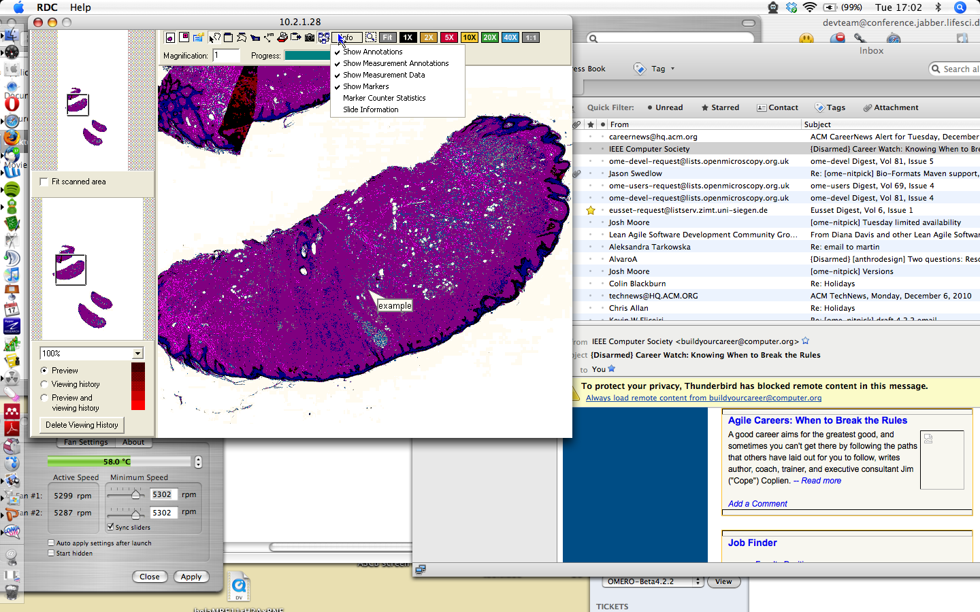
Mirax Viewer
Notes:
Additional feature of a ROI pointer along with the standard set of ROI features to the standard

Slide 5
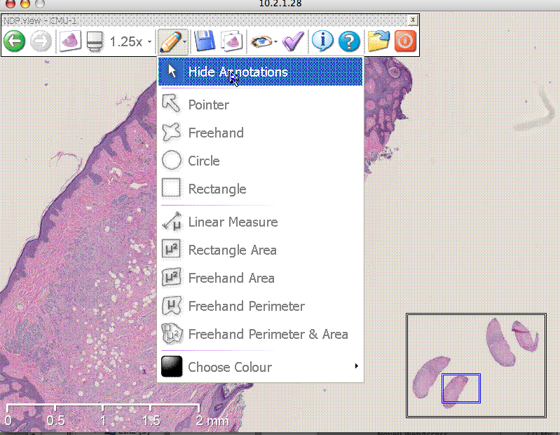
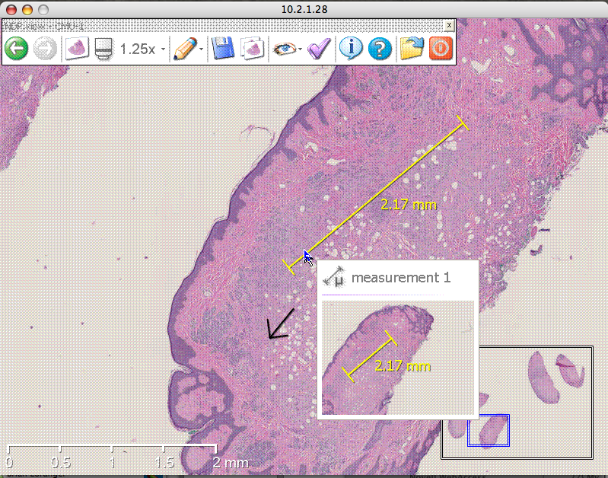
ROI options on Aperio viewer
Thumbnailing of ROI/measurements
Notes:
Additional feature of a ROI pointer, ability to thumbnail ROI measurements

Slide 6
Core requirements Phase 1
Insight
Basic drawing of ROI on big images.
For web Client
Provide the ability to show/hide ROI’s on big images
For future consideration
+ Several of the existing tools provide ready made arrows for indication on the image.

